Slide 1
Social Data Institute
Continuing Professional Development (CPD) course
Introduction To Bayesian Inference & Modelling (2022/23)
Day 1: Introduction to Bayesian INFERENCE
Dr Anwar Musah (a.musah@ucl.ac.uk)
Lecturer in Social and Geographic Data Science
UCL Geography
Additional details:
https://www.ucl.ac.uk/social-data
1

Slide 2
About the course
2
Notes:
But before we start, let’s talk about the course…

Slide 3
Social Data Institute
Description of the course
This course will introduces the foundational and advanced topics on statistical modelling within a Bayesian framework that is highly applicable for any kinds of evidence–based research for academia or industry.
This course broadly covers two areas:
How to use Bayesian Statistics for evidence-based research in making non-spatial and spatial predictions, as well as studying the associations between various risk factors and outcomes through different regression-based models.
Learning how to perform Bayesian Statistics through a software called Stan (i.e., rstan package) which interfaces with RStudio. Here, you will learn a new programming tool.
3

Slide 4
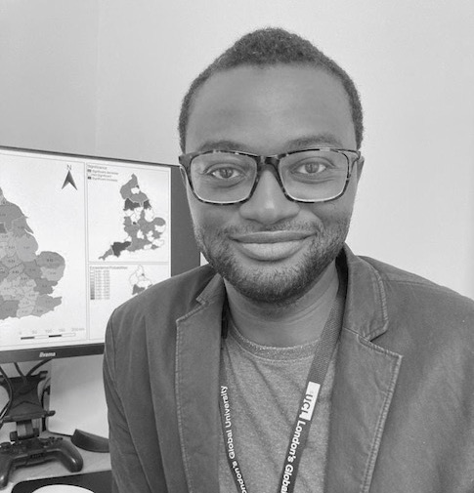



Social Data Institute
Meet the Team
Instructor
UCL SODA
Anwar Musah Lecturer in Social & Geographic Data Science
James Cheshire Academic Director
Moira Hague Institute Manager
Tom O’Grady
Deputy Director
4

Slide 5
Social Data Institute
General format of the course
Times | Session
11:00am to 12:00pm (1h) | Lecture
12:00pm to 01:00pm (1h) | Lunch Break
01:00pm to 02:00pm (1h) | Live Walkthrough & Demonstration
02:00pm to 02:15pm (0h15mins) | Short Break
02:15pm to 03:45pm (1h30mins) | Computer Practical Session
03:45pm to 04:00pm (0h15mins) | Wrap-up
Location(s): Charles Bell House G11, Seminar Room 4, 43-45 Forley Street, W1W 7TY (near tube stations are Goodge Street and Oxford Circus)
NOTE: All lectures and tutorials sessions will be delivered in-person. You are expected to bring you own laptop with the required software and program installed.
5

Slide 6
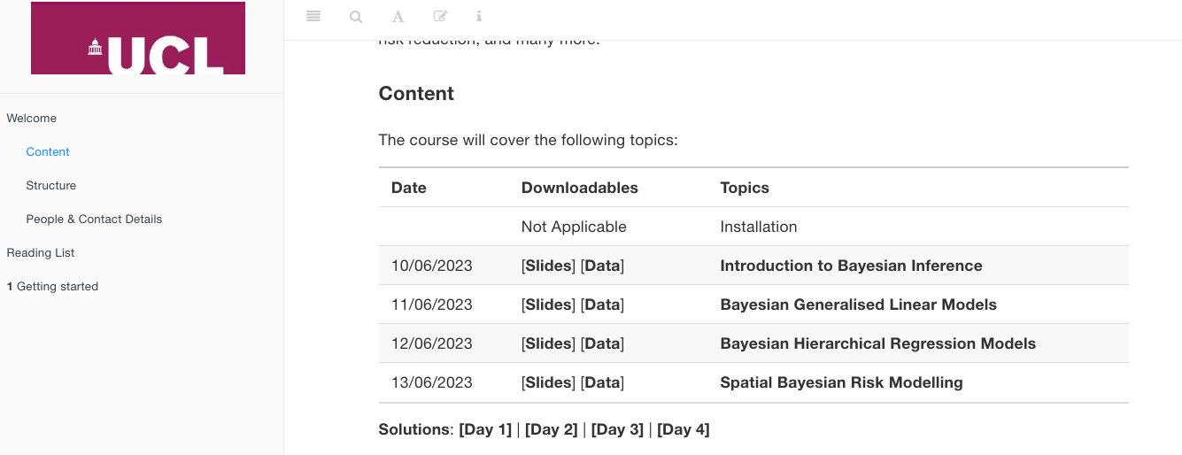
Social Data Institute
Course overview
All the reading list, lecture notes, and information for the computer practicals, as well as their associated live recordings are hosted on a dedicated web-page for this course.
Day 1: Introduction to Bayesian Inference in Stan
Day 2: Bayesian Generalised Linear Modelling (GLMs)
Day 3: Bayesian Hierarchical Modelling
Day 4: Spatial & Spatiotemporal Models
Link: https://uclpg-msc-sgds.github.io/UCL-SODA-CPD-RStan/
Download the lecture and practical materials for that day
6

Slide 7
Social Data Institute
Course overview
Day 1: Introduction to Bayesian Statistics
Day 2: Bayesian Generalised Linear Modelling (GLMs)
Day 3: Bayesian Hierarchical Modelling
Day 4: Spatial & Spatiotemporal Models
All the reading list, lecture notes, and information for the computer practicals, as well as their associated live recordings are hosted on a dedicated web-page for this course.
Access to the reading list for that day’s session
7

Slide 8
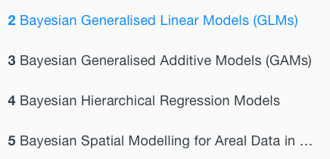
Social Data Institute
Course overview
Day 1: Introduction to Bayesian Statistics
Day 2: Bayesian Generalised Linear Modelling (GLMs)
Day 3: Bayesian Hierarchical Modelling
Day 4: Spatial & Spatiotemporal Models
All the reading list, lecture notes, and information for the computer practicals, as well as their associated live recordings are hosted on a dedicated web-page for this course.
Access to the computer practicals for that day
The solution to the tasks for that day will be opened to you later
8

Slide 9
Social Data Institute
Contents
Problem
What is Bayesian Statistics?
What the types of probability?
What is the Bayes’ theorem?
What are the various Probability distributions?
The basics of Bayesian inference
Book recommendations
Knowledge
Collect
Model
Wrangle
Explore
9

Slide 10
What is a Bayesian Statistics?
10

Slide 11

Social Data Institute
Definition:
Bayesian statistics, is using probabilities to statistical problems (i.e., framing our research questions using probability statements).
Probabilities
Bayes’ Rule
Probability Functions
Bayesian Inference
11

Slide 12
What is a Probability?
12
Notes:
Here, we cover the basic terminology of probability, and learn the three types of probabilities – these basic building blocks will help us to understand what Bayes’ Theorem is --- which is the key to unlocking our understanding of what Bayesian Statistics is all about.

Slide 13
Social Data Institute
Definition:
Probability is the language of uncertainty. It quantifies the uncertainty for a defined event which takes any value between 0 and 1, whereby an event with probabilities near zero implies an event to be very unlikely, and probabilities near one implies an event to be very likely.
The usual notation for probabilities are Pr( ) or P( ) or p( ) or Prob( ) (we will use the notation for P( ) throughout this lecture)
A probability is always a function of some event ‘E’ which has a set number of outcomes as well as the sample space (or population size) which is the total number of all possible outcomes that can occur for that event ‘E’
We can write this and say P(E), which is read as “the probability that event E will occur”
13
Notes:
There are several different definitions of probabilities which honestly don’t make sense at all. The most logical definition(s) of a probability is that its all about uncertainty. How to quantify uncertainty for an event, and using probabilistic framework in statistics to quantify uncertainty.
One can also say – a probability in it is absolute basic form is a quantity for uncertainty for a defined event which can only takes values between 0 and 1 (or expressed as a proportion)
One can also say – a probability is the value that reflects the chance or likelihood that a particular event will occur.
The key ingredients for calculating a probability is knowing the event (i.e., the number times it has occur) and the sample size (total possible outcomes which the event possibly occur)

Slide 14
Social Data Institute
Basic terminology: event, outcome & sample space
In probability, the following means:
An event is referred to as the set of outcomes we can be observe in a study (or experiment).
An outcome refers to one of the possible result that emerge from a study (or experiment).
A sample space is the set of all possible outcomes observed in a study (or experiment)
Example 1: We are conducting a vector-borne mosquito infestation survey in 7 households in an village.
Event: Infestation status of a household which takes discrete outcomes i.e., “Infested” or “Not Infested”
Sample space: All observed 7 outcomes = {Infested, Not Infested, Not Infested, Not Infested, Infested, Not Infested, Infested}
Example 2: We are performing a survey to know the burden of Obesity by measuring BMI status of 10 people.
Event: Obesity status which takes continuous BMI measurements with any value in this range 15.0kg/m² to 66.0kg/m²
Sample space: All observed 10 BMI outcomes = {18.9, 24.7, 32.4, 40.1, 21.4, 29.2, 24.5, 16.3, 19.7, 30.3}
The notation for writing the following:
Probability that a house is infested with mosquitoes = P(Infested)
Probability that a person from this cohort is obese = P(Obesity)
14

Slide 15
Social Data Institute
Example 1: We are conducting a vector-borne mosquito infestation survey in 7 households in an village.
Event: Infestation status of a household which takes discrete outcomes i.e., “Infested” or “Not Infested”
Sample space: All observed 7 outcomes = {Infested, Not Infested, Not Infested, Not Infested, Infested, Not Infested, Infested}
Example 2: We are performing a survey to know the burden of Obesity by measuring BMI status of 10 people.
Event: Obesity status which takes continuous BMI measurements with any value in this range 15.0kg/m² to 66.0kg/m²
Sample space: All observed 10 BMI outcomes = {18.9, 24.7, 32.4, 40.1, 21.4, 29.2, 24.5, 16.3, 19.7, 30.3}
Probability that a house is infested with mosquitoes = Pr(Infested) = (set number of households infested/sample size) = 3/7 = 0.4285 = 42.85%
Probability that a person from this cohort is obese = Pr(Obesity) = (set number of students BMI$≥$30/sample size) = 3/10 = 0.30 = 30.00%
The above instance dealing with ‘single events’ are typical examples of an Unconditional Probability.
There are three major types of probabilities: Unconditional, Joint and Conditional probability.
15
Notes:
I am sure you folks are already aware of how to calculate a probability of a single event
Example of calculating a probability
There are three major types of probabilities

Slide 16
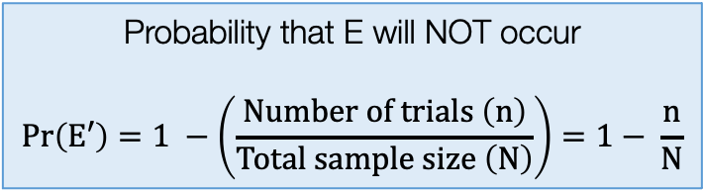
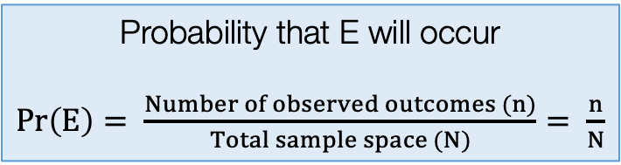
Social Data Institute
Unconditional Probabilities
An unconditional probability is the chance (or likelihood) that a particular event (i.e., single) will occur without regards to external circumstances (i.e., past, present or future).
Usually, the outcome of a single event can be affected by any number of factors; however, with unconditional probabilities, the likelihood of an event ending with a specific results does not account for other conditions that may effect it.
It is also called a Marginal Probability
When there’s data - unconditional (or marginal) probabilities are calculated accordingly as follows:
Note 1:
P(E) + P(E’) = 1
Note 2:
It is basic a prevalence or proportion value
Note 3:
Union (U) in set theory is also the total sample size
Probability that E will occur
$Pr\left(E\right)= \frac{Number of observed outcomes (n)}{Total sample space (N)}= \frac{n}{N}$
Probability that E will NOT occur
$$Pr\left(E′\right)=1 −\left(\frac{Number of trials \left(n\right)}{Total sample size \left(N\right)}\right)=1− \frac{n}{N}$$
We call this complement of E (i.e., E’)
16
Notes:
There are 4 major types of probabilities

Slide 17
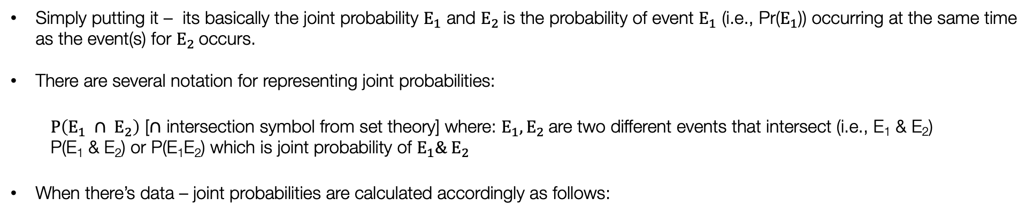

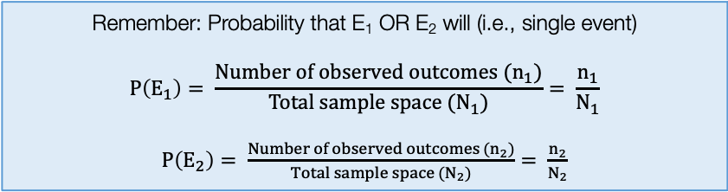
Social Data Institute
Joint Probabilities
A joint probability deals with more than one event. Say, we have two events i.e., $E_{1}$ and $E_{2}$. It is the chance (or likelihood) that these two events will occur simultaneously at the same point in time.
Simply putting it – its basically the joint probability $E_{1}$ and $E_{2}$is the probability of event $E_{1}$ (i.e., Pr($E_{1}$)) occurring at the same time as the event(s) for $E_{2}$occurs.
There are several notation for representing joint probabilities:
$P\left(E_{1} ∩ E_{2}\right)$ [$∩$ intersection symbol from set theory] where: $E_{1}, E_{2}$are two different events that intersect (i.e., E₁ & E₂)
P(E₁ & E₂) or P(E₁E₂) which is joint probability of $E_{1}\& E_{2}$
When there’s data – joint probabilities are calculated accordingly as follows:
Remember: Probability that E₁ OR E₂ will (i.e., single event)
$$P\left(E_{1}\right)= \frac{Number of observed outcomes (n_{1})}{Total sample space (N_{1})}= \frac{n_{1}}{N_{1}}$$
$P\left(E_{2}\right)= \frac{Number of observed outcomes (n_{2})}{Total sample space (N_{2})}= \frac{n_{2}}{N_{2}}$
Note 1: You need to calculate the conditional probabilities and multiply them to get the joint.
Note 2: When you think of joint always think on multiplication
Note 3: Pr(AnB)/U
The joint probabilities are:
$P\left(E_{1} \& E_{2}\right)= P\left(E_{1}\right)$ $P\left(E_{2}\right)$
17
Notes:
Update this formula

Slide 18
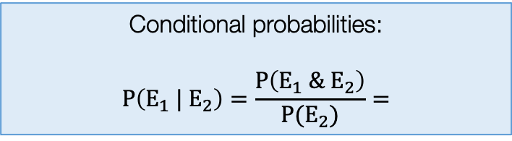
Social Data Institute
Conditional Probabilities
A conditional probability of an event $E_{1}$ is the probability that $E_{1}$ will occur given the knowledge that an event $E_{2}$ has already occurred.
Simply putting it – it’s the likelihood of an event E₁ occurring, based on the occurrence of a previous event E₂.
We say: “Probability of E₁ given E₂” – where the probability of event E₁ depends on that of E₂ has happened
The notation for representing conditional probabilities:
“|” to represent given
Pr(E₁ | E₂) which means the probability of E₁ given E₂
Conditional probabilities are computed accordingly as follows:
Conditional probabilities:
$$P\left(E_{1} |{ E}_{2}\right)=\frac{P\left(E_{1} \& E_{2}\right)}{P⁡(E_{2})}=$$
Notes: Calculating the conditional probabilities
are quite involved. You will need to calculated the
joint probabilities of E1 and E2, and unconditional
probability of E2 and divide them together.
18

Slide 19
Social Data Institute
Example: Study on measuring abundance of Adult mosquitoes in Location A [1]
 | Breeding sites: Aedes | Breeding sites: No Aedes | Sum (Row)
Urban | 182 | 1008 | 1190
Rural | 132 | 861 | 993
Sum (Column) | 314 | 1869 | Grand total: 2183
Interested in the adult mosquito abundance from breeding sites within a urban/rural setting
Let the B represent the event Breeding sites: Aedes
Let the B’ represent the event Breeding sites: No Aedes
Let the U represent the event urban area (i.e., total number of breeding sites found in a urban setting)
Let the U’ represent the event rural area (i.e., total number of breeding sites found in a rural setting)
19

Slide 20
Social Data Institute
Example: Study on measuring abundance of Adult mosquitoes in Location A [2]
 | Breeding sites: Aedes | Breeding sites: No Aedes | Sum (Row)
Urban | 182 | 1008 | 1190 (/2183)
Rural | 132 | 861 | 993 (/2183)
Sum (Column) | 314 (/2183) | 1869 (/2183) | Grand total: 2183
Here, we can compute the probabilities by simply dividing the number of events observed by the overall total sample space which is 2183
The second table, we have simply converted the raw values to probabilities. The light blue shaded cells are the unconditional(or marginal) probabilities
 | Breeding sites: Aedes (B) | Breeding sites: No Aedes (B’) | Sum (Row)
Urban (U) |  |  | 0.55 = P(U)
Rural (U’) |  |  | 0.45 = P(U’)
Sum (Column) | 0.14 = P(B) | 0.86 = P(B’) | Grand total: 1
Note they must add to 1:
0.55 + 0.45 = 1
0.14 + 0.86 = 1
20
Computing the Unconditional Probabilities

Slide 21
Social Data Institute
Example: Study on measuring abundance of Adult mosquitoes in Location A [2]
 | Breeding sites: Aedes | Breeding sites: No Aedes | Sum (Row)
Urban | 182 | 1008 | 1190 (/2183)
Rural | 132 | 861 | 993 (/2183)
Sum (Column) | 314 (/2183) | 1869 (/2183) | Grand total: 2183
 | Breeding sites: Aedes (B) | Breeding sites: No Aedes (B’) | Sum (Row)
Urban (U) | B & U | B’ & U | 0.55 P(U)
Rural (U’) | B & U’ | B’ & U’ | 0.45 P(U’)
Sum (Column) | 0.14 P(B) | 0.86 P(B’) | Grand total: 1
In the second table, we can convert these raw values to joint probabilities. The dark blue shaded cells are the joints probabilities by multiplying their corresponding unconditional probabilities.
21
Computing the Joint Probabilities

Slide 22
Social Data Institute
Example: Study on measuring abundance of Adult mosquitoes in Location A [3]
 | Breeding sites: Aedes | Breeding sites: No Aedes | Sum (Row)
Urban | 182 | 1008 | 1190 (/2183)
Rural | 132 | 861 | 993 (/2183)
Sum (Column) | 314 (/2183) | 1869 (/2183) | Grand total: 2183
 | Breeding sites: Aedes (B) | Breeding sites: No Aedes (B’) | Sum (Row)
Urban (U) | 0.077 = Pr(B & U) | 0.473 = Pr(B’ & U) | 0.55 = Pr(U)
Rural (U’) | 0.063 = Pr(B & U’) | 0.387 = Pr(B’ & U’) | 0.45 = Pr(U’)
Sum (Column) | 0.14 = Pr(B) | 0.86 = Pr(B’) | Grand total: 1
In the second table, we can convert these raw values to joint probabilities. The dark blue shaded cells are the joints probabilities by multiplying their corresponding unconditional probabilities.
Example: P(B & U) = P(U)*P(B) etc
P(B & U) = 0.55 x 0.14 = 0.077
P(B & U’) = 0.45 x 0.14 = 0.063
P(B’ & U) = 0.55 x 0.86 = 0.08
P(B’ & U’) = 0.45 x 0.86 = 0.08
Note they must add to 1: 0.387+0.473+0.063+0.077 = 1
22
Computing the Joint Probabilities

Slide 23

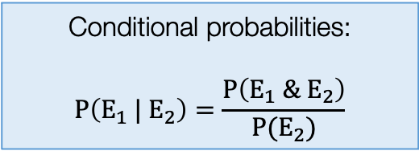
Social Data Institute
Example: Study on measuring abundance of Adult mosquitoes in Location A [3]
 | Breeding sites: Aedes | Breeding sites: No Aedes | Sum (Row)
Urban | 182 | 1008 | 1190
Rural | 132 | 861 | 993
Sum (Column) | 314 | 1869 | Grand total: 2183
 | Breeding sites: Aedes (B) | Breeding sites: No Aedes (B’) | Sum (Row)
Urban (U) | 0.08 = Pr(B & U) | 0.46 = Pr(B’ & U) | 0.55 = Pr(U)
Rural (U’) | 0.04 = Pr(B & U’) | 0.39 = Pr(B’ & U’) | 0.45 = Pr(U’)
Sum (Column) | 0.14 Pr(B) | 0.86 Pr(B’) | Grand total: 1
Suppose, we want to know what’s the probability of a breeding site has the Aedes given the setting is urban i.e., Pr(B|U), a conditional probability.
Conditional probabilities:
$$P\left(E_{1} |{ E}_{2}\right)=\frac{P\left(E_{1} \& E_{2}\right)}{P(E_{2})}$$
$$P\left(B | U\right)= \frac{P⁡(B \& U)}{P⁡(U)}=\frac{0.08}{0.55}=0.1454=14.54\%$$
23
Computing Conditional Probabilities
In real-life, nobody’s going to ask you to do these annoying calculations!

Slide 24
Probabilities
Bayes’ Rule
Probability Functions
Bayesian Inference
24

Slide 25
Bayes’ Theorem
25

Slide 26
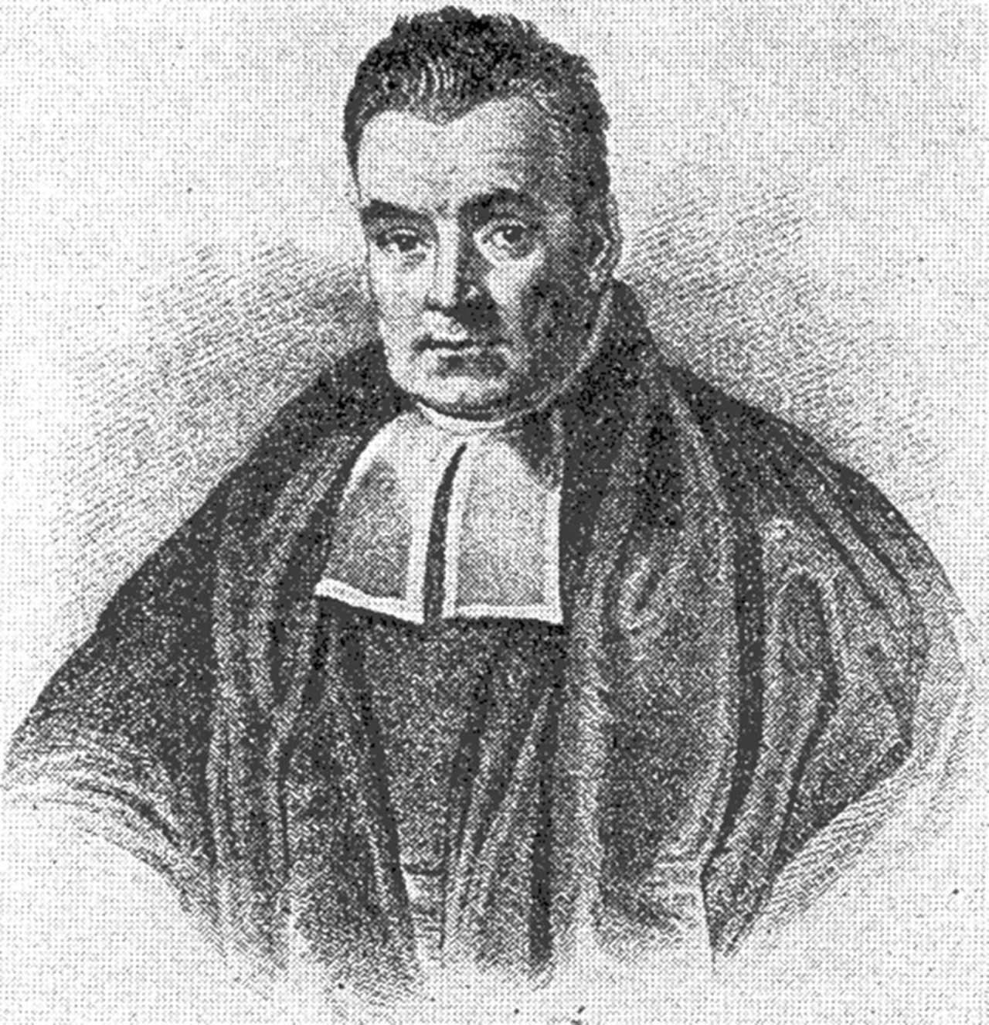


Social Data Institute
Definition:
Bayes’ theorem (or law) determines the conditional probability of a hypothesis (i.e., event) being true given the evidence (i.e., data).
It’s a mathematical formula comprising of conditional and marginal probabilities
It expresses how a subjective degree of belief should rationally change to account for evidence
The basic formulation for Bayes’ Theorem (or Law):
Probability the hypothesis is true (before any evidence is present)
Thomas Bayes (1701 – 1761)
$$Pr\left(H | E\right)= \frac{Pr\left(H\right) Pr\left(E \right| H)}{Pr⁡(E)}$$
Probability of seeing the evidence IF the hypothesis is true
Probability that a hypothesis is true given the evidence
Probability of observing hypothesis in light of the evidence
26

Slide 27

Social Data Institute
Prior probability (our belief, we usually don’t know)
Probability the hypothesis is true (before any evidence is present)
Likelihood probability (derived from data)
$$Pr\left(H | E\right)= \frac{Pr\left(H\right) Pr\left(E \right| H)}{Pr⁡(E)}$$
Probability of seeing the evidence IF the hypothesis is true
Probability that a hypothesis is true given the evidence
Posterior probability
Probability of observing the evidence
Model prior probability (our belief, we usually don’t know)
H is the hypothesis whose probability may be affected by data (i.e., evidence)
Pr(H), the unconditional probability pertained to hypothesis is our prior probability
Pr(E|H) is the conditional probability of observing the data (i.e., evidence) given the hypothesis. Here, it indicates the compatibility between the data and hypothesis. This is our likelihood.
Pr(H|E), is conditional probability i.e., what we want to know – the probability of a hypothesis given after we observed the data. This is the posterior probability.
Pr(E) is the unconditional probability for observing the data
27

Slide 28


The basic formulation for Bayes’ Theorem (or Law):
Without derivation!
Prior probability (our belief, we usually don’t know)
Probability the hypothesis is true (before any evidence is present)
Likelihood probability (derived from data)
$$Pr\left(H | E\right)= \frac{Pr\left(H\right) Pr\left(E \right| H)}{Pr⁡(E)}$$
Probability of seeing the evidence IF the hypothesis is true
Probability that a hypothesis is true given the evidence
Posterior probability
Probability of observing the evidence
Model prior probability (our belief, we usually don’t know)
The expanded version of the Bayes’ Theorem (or Law):
$$Pr\left(H | E\right)= \frac{Pr\left(H\right) Pr\left(E \right| H)}{\operatorname{Pr}\left(H\right)Pr\left(E \right|H) +\operatorname{Pr}\left(E | { H}^{′}\right)Pr⁡(H^{′})}$$
This is still Pr(E) i.e., the probability of observing the evidence
The great thing about this equation is the fact that it allows us to posit specific hypotheses for some phenomena and in turn express our current belief that each hypothesis is true. Then, as new information (i.e., data) becomes available, we update our belief in the hypothesis.
Let’s see the Bayes’ theorem in action!
28

Slide 29
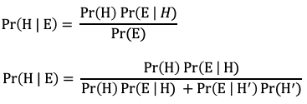
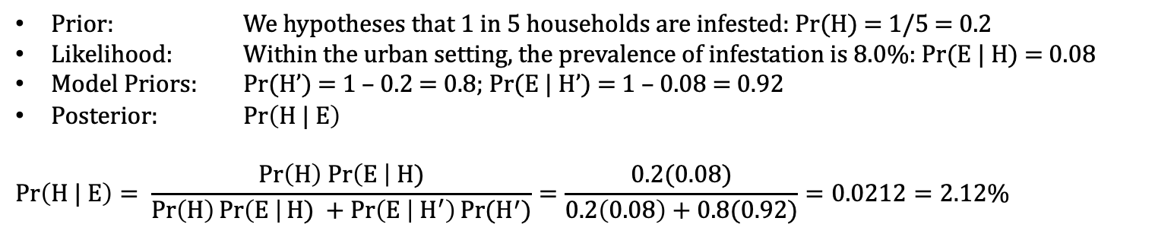
Social Data Institute
Example with Bayes’ Rule: Study on measuring abundance of Adult mosquitoes in Location A within urban setting
 | Breeding sites: Aedes | Breeding sites: No Aedes | Sum (Row)
Urban | 182 | 1008 | 1190
Rural | 132 | 861 | 993
Sum (Column) | 314 | 1869 | Grand total: 2183
After engaging with community workers about mosquito infestation in Location A. We suspect that households in Location A have a 1 in 5 risk are infested with the Aedes mosquitoes. From a previous survey, the prevalence of infestation based on an urban setting is 8.0%. How probable is it that households within a urban slum setting are infested with Aedes mosquito?
Prior: We hypotheses that 1 in 5 households are infested: Pr(H) = 1/5 = 0.2
Likelihood: Within the urban setting, the prevalence of infestation is 8.0%: Pr(E | H) = 0.08
Model Priors: Pr(H’) = 1 – 0.2 = 0.8; Pr(E | H’) = 1 – 0.08 = 0.92
Posterior: $Pr\left(H | E\right)$
$$Pr\left(H | E\right)= \frac{Pr\left(H\right) Pr\left(E \right| H)}{\operatorname{Pr}\left(H\right)Pr\left(E \right|H) +\operatorname{Pr}\left(E | { H}^{′}\right)Pr⁡(H^{′})}=\frac{0.2(0.08)}{0.2\left(0.08\right)+0.8(0.92)}=0.0212=2.12\%$$
29
Notes:
We might not have all the data – show updating the posterior probability

Slide 30
Probabilities
Bayes’ Rule
Probability Functions
Bayesian Inference
30

Slide 31
Probability Distributions
31
Notes:
We use

Slide 32
Social Data Institute
Definition:
Probability distribution is a mathematical function that churns out the probability of observing a particular value for a variable (or event). They allow us to also estimate the cumulative probability up to a certain value.
There are broadly two groups for probability distributions with several subtypes:
Probability Mass Function (PMFs) (Discrete)
Discrete uniform distribution
Bernoulli distribution
Binomial distribution
Poisson distribution
Probability Density Function (PDFs) (Continuous)
Uniform distribution
Gaussian (or Normal) distribution
Gamma distribution (flexible)
Beta distribution (flexible)
Note: These distributions can handle variables that counts, or a discrete (or distinct) in nature.
Note: These distributions can handle variables that are continuous in nature
Important note:
In Bayesian inference, we will have apply probability distributions to the various components of the Bayes’ rule formula for the likelihood function and prior probability to derive the posterior probability.
We impose a probability distribution to model an outcome (likelihood), while we subjectively choose another probability distribution (according to our believes) that best describes the shape of the parameters we want to estimate from our outcome
32

Slide 33
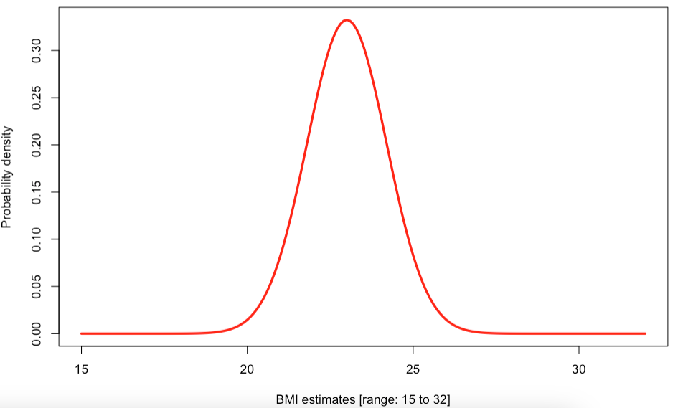

Social Data Institute
Understanding how to generate a probability distribution [Part 1]:
The key information is knowing the characteristic of the variable, as well as the parameters to be specified or estimated. This will dictate how you will select the appropriate probability distribution.
For instance, BMI in children (an interval measure) ranging from 15.0 to 32.0 from school reception, and for the parameters, we have knowledge about them (i.e., say mean and SD)
Red line: $μ=23.0, σ=1.2$
When determining the probability distribution of such variable. Consider the following:
Characteristic: Here, the BMI measure is an interval and hence continuous; we are using a PDF (probability density function)
Shape: Plot of the BMI data strictly resembles a bell curve (which is either centred or shifted) – indicates normality
Parameters: The parameter’s you have knowledge of a mean and SD.
Probability Density Function: Gaussian (or Normal) Distribution
How was this PDF created?
33

Slide 34

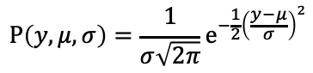
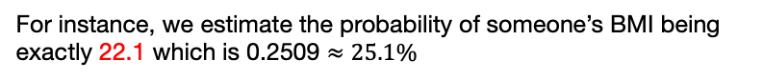
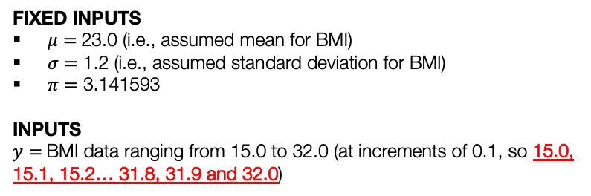
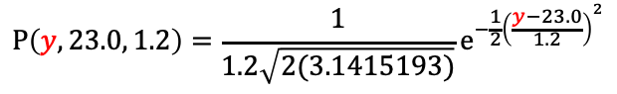
Social Data Institute
Gaussian (or Normal) Distribution [1]
What is this used for?
To get a point probability estimate for a measured value (i.e. a probability density)
To get a cumulative probability.
$$P\left(y, μ, σ\right)=\frac{1}{σ\sqrt{2π}}e^{−\frac{1}{2}{\left(\frac{y−μ}{σ}\right)}^{2}}$$
$$⇠⇢norm(μ,σ)$$
Estimate point probability estimate for some measure of BMI value
dnorm(22.1, mean = 23, sd=1.2)
FIXED INPUTS
$μ=$23.0 (i.e., assumed mean for BMI)
$σ=$ 1.2 (i.e., assumed standard deviation for BMI)
$π=$ 3.141593
INPUTS
$y=$BMI data ranging from 15.0 to 32.0 (at increments of 0.1, so 15.0, 15.1, 15.2… 31.8, 31.9 and 32.0)
P(22.1, 23.0, 1.2)
$$P\left(y, 23.0, 1.2\right)=\frac{1}{1.2\sqrt{2(3.1415193)}}e^{−\frac{1}{2}{\left(\frac{y−23.0}{1.2}\right)}^{2}}$$
Finding the probability that someone’s BMI is 22.1
22.1
For instance, we estimate the probability of someone’s BMI being exactly 22.1 which is 0.2509 $≈25.1\%$
34

Slide 35
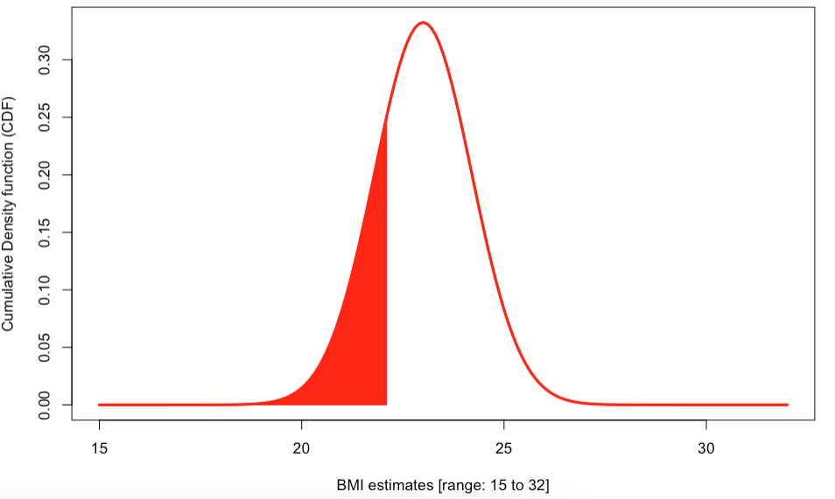
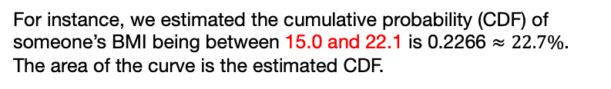
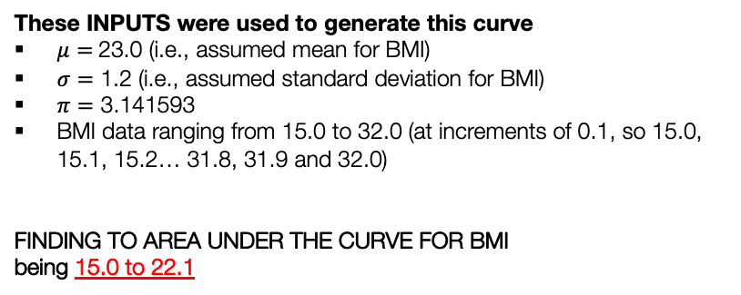
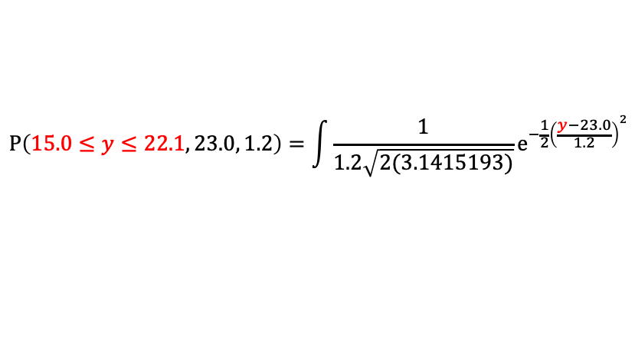
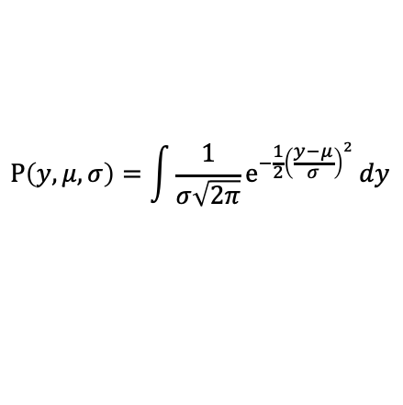

Social Data Institute
Gaussian (or Normal) Distribution [2]
What is this used for?
To get a point probability estimate for a measured value (i.e. a probability density)
To get a cumulative probability.
$$P\left(y, μ, σ\right)=\int{\frac{1}{σ\sqrt{2π}}e^{−\frac{1}{2}{\left(\frac{y−μ}{σ}\right)}^{2}}}dy$$
$$⇠⇢norm(μ,σ)$$
Estimate the cumulative probability (cumulative density function [CDF]) for some range of BMI values
These INPUTS were used to generate this curve
$μ=$23.0 (i.e., assumed mean for BMI)
$σ=$ 1.2 (i.e., assumed standard deviation for BMI)
$π=$ 3.141593
BMI data ranging from 15.0 to 32.0 (at increments of 0.1, so 15.0, 15.1, 15.2… 31.8, 31.9 and 32.0)
FINDING TO AREA UNDER THE CURVE FOR BMI
being 15.0 to 22.1
pnorm(22.1, mean = 23, sd=1.2, lower.tail = TRUE)
$$P\left(15.0≤y≤22.1, 23.0, 1.2\right)=\int{\frac{1}{1.2\sqrt{2(3.1415193)}}e^{−\frac{1}{2}{\left(\frac{y−23.0}{1.2}\right)}^{2}}}$$
Finding the probability that someone’s BMI is at most 22.1
For instance, we estimated the cumulative probability (CDF) of someone’s BMI being between 15.0 and 22.1 is 0.2266 $≈22.7\%$. The area of the curve is the estimated CDF.
15.0
22.1
35

Slide 36
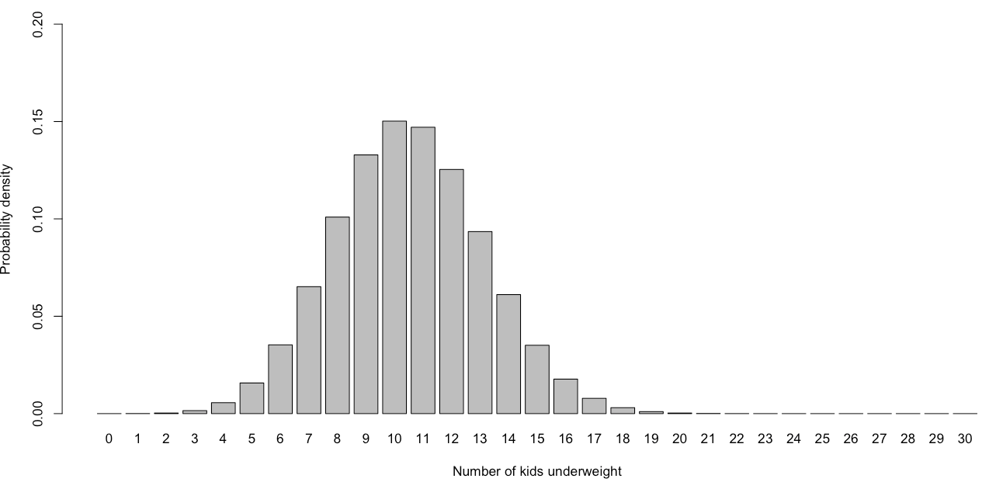
Social Data Institute
Understanding how to generate a probability distribution [Part 2]:
The key information is knowing the characteristic of the variable, as well as the parameters to be specified or estimated. This will dictate how you will select the appropriate probability distribution.
For instance, we want find out the prevalence of children in reception who are underweight (BMI < 17.5). Without data, we have prior knowledge that 35% of kids are underweight. We understand what the probability will be in observing 7 kids (out of 30 in classroom) being underweight.
When determining the probability distribution of such variable. Consider the following:
Characteristic: Here, the outcome measure is an proportion (i.e., 7 out of 30) with details on numerator and denominator; and hence it discrete; it’s aggregated binary measure and so we are using a PMF (probability mass function)
Parameters: The parameter’s you have knowledge of is a proportion.
Probability Mass Function: Binomial Distribution
How was this PMF created?
36

Slide 37

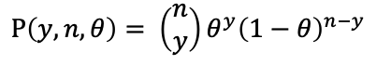

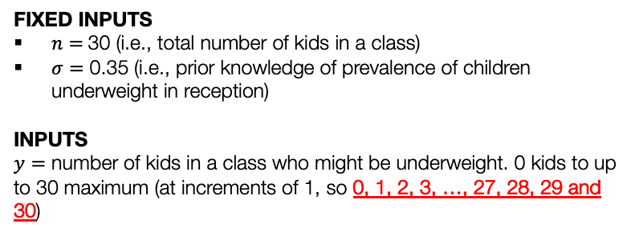
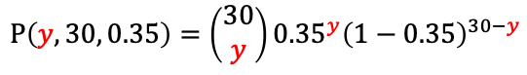
Social Data Institute
Binomial Distribution [1]
What is this used for?
To get a point probability estimate for a measured value (i.e. a probability density)
To get a cumulative probability.
$$P\left(y, n, θ\right)= \left(\begin{matrix}n \\ y\end{matrix}\right)θ^{y}{\left(1−θ\right)}^{n−y}$$
$$⇠⇢bin(n,θ)$$
Estimate point probability estimate for some number of children who are underweight
FIXED INPUTS
$n=$30 (i.e., total number of kids in a class)
$σ=$ 0.35 (i.e., prior knowledge of prevalence of children underweight in reception)
INPUTS
$y=$ number of kids in a class who might be underweight. 0 kids to up to 30 maximum (at increments of 1, so 0, 1, 2, 3, …, 27, 28, 29 and 30)
dbinom(7, size = 30, prob=0.35)
$$P\left(y, 30, 0.35\right)=\left(\begin{matrix}30 \\ y\end{matrix}\right){0.35}^{y}{\left(1−0.35\right)}^{30−y}$$
P(7, 30, 0.35)
Finding the probability 7 children being underweight (i.e., y = 7)
For instance, we estimate the probability of 7 kids (out of 30 in classroom) being underweight is 0.06519 $≈6.52\%$
37

Slide 38
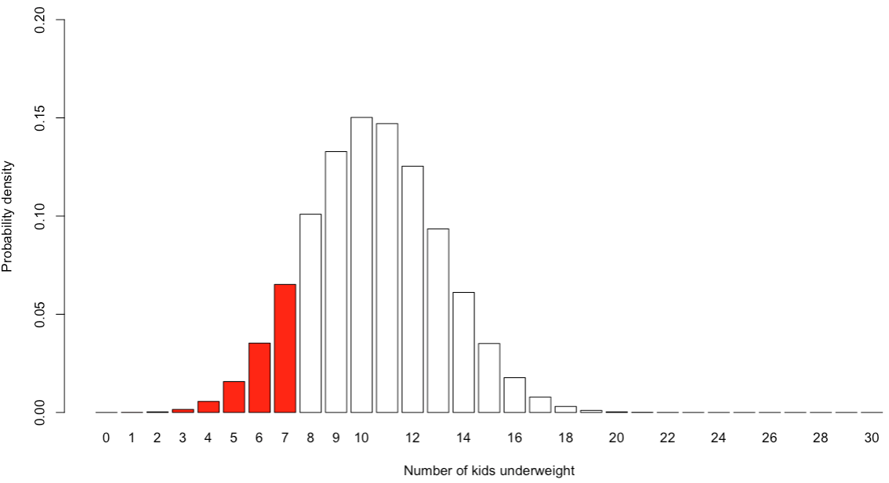
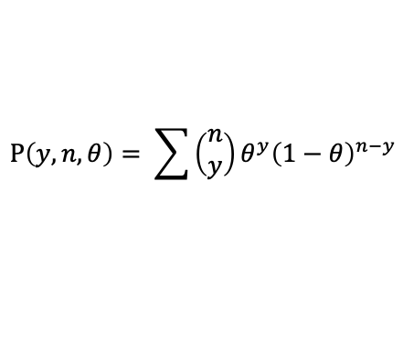
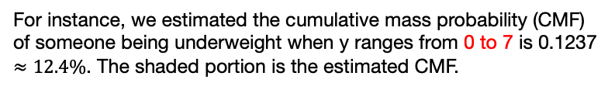
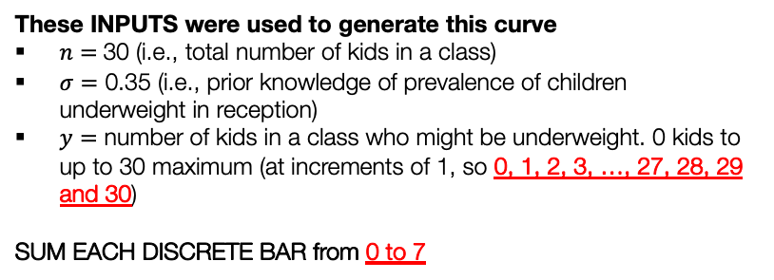
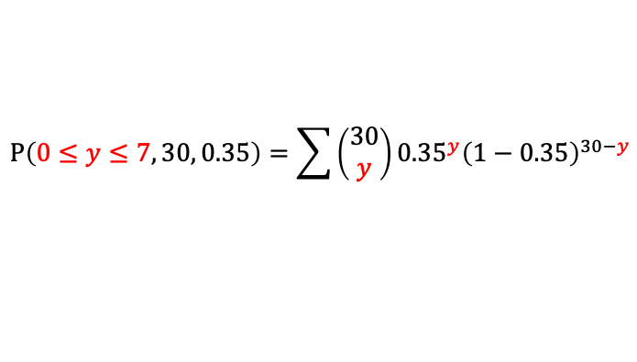

Social Data Institute
Binomial Distribution [2]
What is this used for?
To get a point probability estimate for a measured value (i.e. a probability density)
To get a cumulative probability.
$$P\left(y, n, θ\right)= \sum{\left(\begin{matrix}n \\ y\end{matrix}\right)θ^{y}{\left(1−θ\right)}^{n−y}}$$
$$⇠⇢bin(n,θ)$$
Estimate the cumulative probability (cumulative mass function [CMF]) for some range of values
These INPUTS were used to generate this curve
$n=$30 (i.e., total number of kids in a class)
$σ=$ 0.35 (i.e., prior knowledge of prevalence of children underweight in reception)
$y=$ number of kids in a class who might be underweight. 0 kids to up to 30 maximum (at increments of 1, so 0, 1, 2, 3, …, 27, 28, 29 and 30)
SUM EACH DISCRETE BAR from 0 to 7
pbinom(7, size = 30, prob=0.35, lower.tail = TRUE)
$$P\left(0≤y≤7, 30, 0.35\right)=\sum{\left(\begin{matrix}30 \\ y\end{matrix}\right){0.35}^{y}{\left(1−0.35\right)}^{30−y}}$$
Finding the probability with y being at most up to 7
For instance, we estimated the cumulative mass probability (CMF) of someone being underweight when y ranges from 0 to 7 is 0.1237 $≈12.4\%$. The shaded portion is the estimated CMF.
38

Slide 39

Probabilities
Bayes’ Rule
Probability Functions
Bayesian Inference
39

Slide 40
Bayesian Inference
40

Slide 41
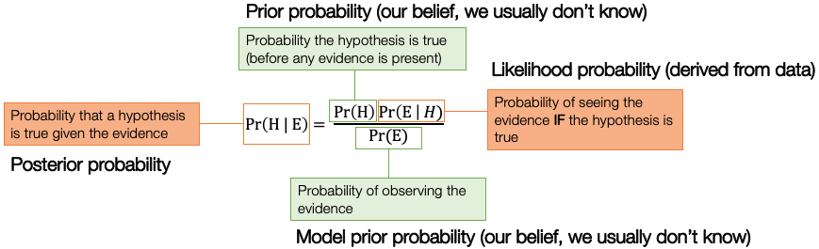
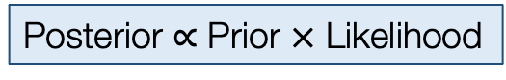
Social Data Institute
Definition:
Bayesian inference is the extension of the Bayes’ theorem (or law/rule) which is used to update the probability about the hypothesis as more evidence or information becomes available.
This particular branch of statistics uses the Bayes’ theorem (or law/rule) to solve inferential questions of interest where H (Hypothesis) is unknown & E (Evidence) represents the data
>>
Posterior $∝$ Prior $×$ Likelihood
41
Notes:
Bayesian inference with a

Slide 42
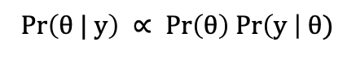
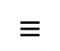
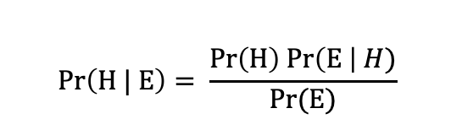
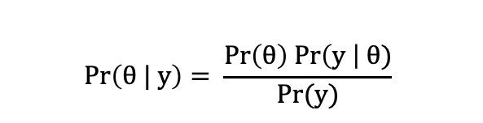
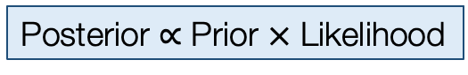
Social Data Institute
Back to the Bayes’ Theorem and re-writing the formula [1]
Posterior $∝$ Prior $×$ Likelihood
We’ll come back to this!
Re-write the formula and expressing it in terms of y (data or evidence) and $θ$ (hypothesis or parameter) to estimate
$$Pr\left(H | E\right)= \frac{Pr\left(H\right) Pr\left(E \right| H)}{Pr⁡(E)}$$
$$Pr\left(θ | y\right)= \frac{Pr\left(θ\right) Pr\left(y \right| θ)}{Pr⁡(y)}$$
$$≡$$
>>
$$Pr\left(θ | y\right) ∝ Pr\left(θ\right) Pr\left(y \right| θ)$$
This can removed since we only care about the ones with $θ$
42

Slide 43
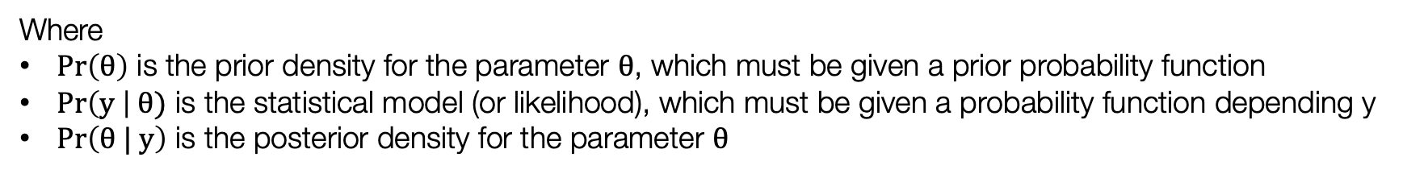
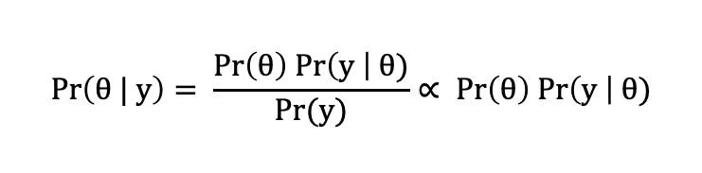
Social Data Institute
Back to the Bayes’ Theorem and re-writing the formula [2]
For point or interval estimation of a parameter $θ$, the inference is based off:
$$Pr\left(θ | y\right)= \frac{Pr\left(θ\right) Pr\left(y \right| θ)}{Pr⁡(y)}∝ Pr\left(θ\right) Pr\left(y \right| θ)$$
Where
$Pr\left(θ\right)$ is the prior density for the parameter $θ$, which must be given a prior probability function
$Pr\left(y \right| θ)$ is the statistical model (or likelihood), which must be given a probability function depending y
$Pr\left(θ | y\right)$ is the posterior density for the parameter $θ$
Specifying the likelihood’s probability function is very easy. Often, you will be using normal, Poisson or binomial distribution to deal continuous, counts, or binary outcomes respectively.
The difficulty lies in the specification of the prior probability function. Here its entirely subjective.
43
Notes:
It is common practice to re-wite the Bayesian inference model with the proportional symbol – and

Slide 44
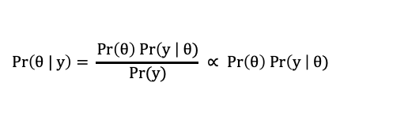
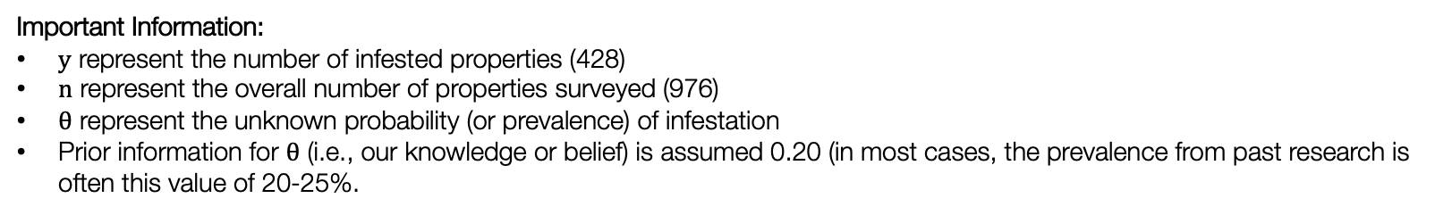
Social Data Institute
Motivating example [1]:
$$Pr\left(θ | y\right)= \frac{Pr\left(θ\right) Pr\left(y \right| θ)}{Pr⁡(y)} ∝ Pr\left(θ\right) Pr\left(y \right| θ)$$
What is the probability (or prevalence) of infestation in Recife this year?
Survey year: 05/2023 | Number properties detected with Aedes | Overall number of properties surveyed
* Most recent data collection effort. | 428 | 976
Important Information:
$y$ represent the number of infested properties (428)
$n$ represent the overall number of properties surveyed (976)
$θ$ represent the unknown probability (or prevalence) of infestation
Prior information for $θ$ (i.e., our knowledge or belief) is assumed 0.20 (in most cases, the prevalence from past research is often this value of 20-25%.
Likelihood function: $P\left(y \right| θ)$ = $\left({n \atop y}\right)θ^{y}{(1−θ)}^{n−y}$
Alternatively, instead type this mathematical notation, you use this statistical notation: $y \sim Bin(n, θ)$
We have specified the probability function for the likelihood, what about the function for the prior i.e., $P(θ)$?
44

Slide 45
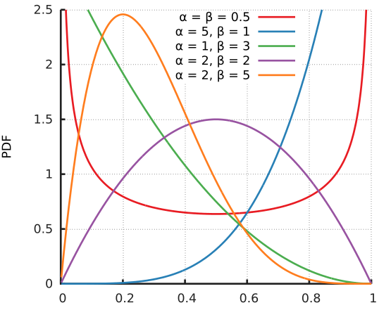
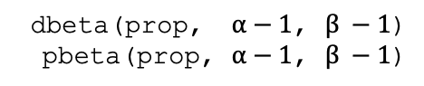
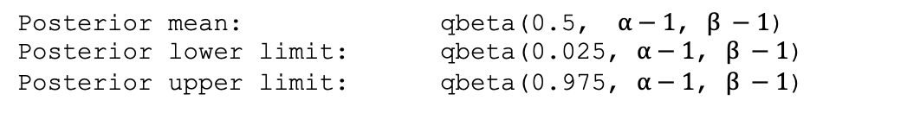
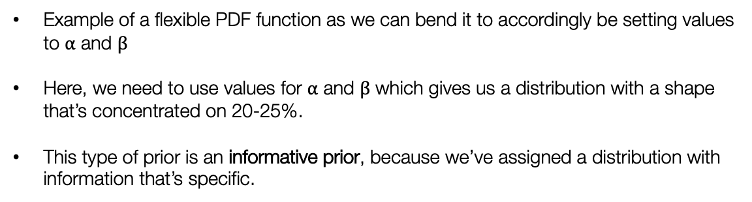
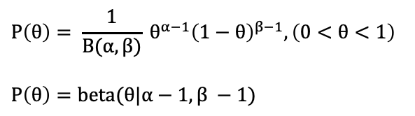
Social Data Institute
dbeta(prop, $α−1$, $β −1$)
pbeta(prop, $α−1$, $β −1$)
Motivating example [2]:
The probability distribution needed in this situation is a Beta distribution. It is the best probability function to use a prior distribution for unknown parameter that’s a proportion.
$$P\left(θ\right)= \frac{1}{B(α,β)} θ^{α−1}{\left(1−θ\right)}^{β−1}, \left(0<θ<1\right)$$
$$P\left(θ\right)=beta(θ|α−1, β −1)$$
Posterior mean: qbeta(0.5, $α−1$, $β −1$)
Posterior lower limit: qbeta(0.025, $α−1$, $β −1$)
Posterior upper limit: qbeta(0.975, $α−1$, $β −1$)
Example of a flexible PDF function as we can bend it to accordingly be setting values to $α$ and $β$
Here, we need to use values for $α$ and $β$ which gives us a distribution with a shape that’s concentrated on 20-25%.
This type of prior is an informative prior, because we’ve assigned a distribution with information that’s specific.
45
Notes:
B(alpha, beta) is a normalisation constant term. It controls the way the curve looks.

Slide 46
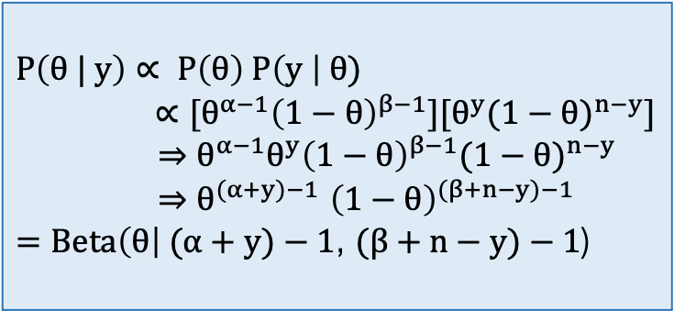
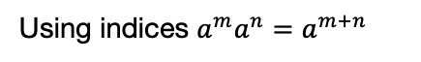
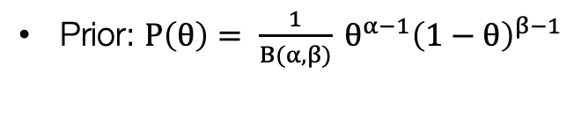
Social Data Institute
Solutions [1]:
Likelihood function: $P\left(y \right| θ)$ = $\left({n \atop y}\right)θ^{y}{(1−θ)}^{n−y}$
Prior: $P\left(θ\right)= \frac{1}{B(α,β)} θ^{α−1}{\left(1−θ\right)}^{β−1}$
For a binomial model specification, with Beta prior, the posterior is:
$$P\left(θ | y\right)∝ P\left(θ\right) P\left(y \right| θ)$$
$∝[θ^{α−1}{\left(1−θ\right)}^{β−1}][θ^{y}{(1−θ)}^{n−y}]$
$⇒θ^{α−1}{θ^{y}\left(1−θ\right)}^{β−1}{(1−θ)}^{n−y}$
${⇒θ}^{(α+y)−1}{\left(1−θ\right)}^{(β+n−y)−1}$
$=Beta\left(θ\right| (α+y)−1$, $(β+n−y)−1$)
All constants with the parameter of interest can be removed i.e., $\left({n \atop y}\right)$ and $\frac{1}{B(α,β)}$
Arranging like terms so $θ$’s and $(1−θ)$’s together
Using indices $a^{m}a^{n}=a^{m+n}$
As you can see the posterior distribution is a Beta distribution, but the parameters for it have been updated.
When the posterior is in the same family as the prior, we say the prior is a conjugate for the model.
Here, the Beta prior is a conjugate for the binomial model.
46
Notes:
Remember all

Slide 47


Social Data Institute
Solutions [2]:
$$\text{Updated} \text{Bayesian} \text{model}: P(θ|Y){ ∝ θ}^{(α+y)−1}{\left(1−θ\right)}^{(β+n−y)−1}$$
Combining this with infestation data, the posterior is $Beta\left(θ\right| (α+y)−1$, $(β+n−y)−1$)
Using a informative prior in this situation, where $α$ = 1 and $β$ = 5, we get the following
$Beta\left(θ\right| (1+428)−1$, ($5+976−428)−1$)
Above model will generate a posterior distribution where $θ$ is from 0 to 1.
The mean prevalence is approximately 44% with 95% credible intervals (40% to 47%)
Posterior mean: qbeta(0.5, $(1+428−1$, $(5+976−428) −1$)
Posterior lower limit: qbeta(0.025, $(1+428−1$, $(5+976−428) −1$)
Posterior upper limit: qbeta(0.975, $(1+428−1$, $(5+976−428) −1$)
47

Slide 48
Selection of priors for Likelihood $P(Y|θ)$ or Priors $P(θ)$
Characteristic | Check shape | Function | Distribution | Statistical Notation | Usage
Continuous measure (scale, interval) | Bell shape (centre, or shifted) | PDF | Gaussian | norm(mu, sigma) | Set it as a likelihood Use as prior
Proportion (with information on the numerator and denominator) | Does not matter | PMF | Binomial | bin(n, p) | Set it as a likelihood (only)
Counts | Does not matter | PMF | Poisson | poisson(rate) | Set it as a likelihood (only)
Binary measure (Yes, No) | Does not matter | PMF | Bernoulli | bern(p) | Set it as a likelihood (only)
Continuous measure (scale, interval) Proportion (with information on the numerator and denominator) Counts | Flat shape | PDF/PMF | Uniform | uniform(a, b) | Use ONLY as a prior Use it if you don’t have any prior information This is an uninformative prior
Continuous measure (scale, interval) Counts | Skewed shape | PDF/PMF | Gamma | Gamma(rate, shape) | Use ONLY as a prior It’s flexible
Proportion (with information on the numerator and denominator) | Does not matter | PDF | Beta | Beta(theta, shape1, shape2) | Use ONLY as a prior It’s flexible
48

Slide 49
Probabilities
Bayes’ Rule
Probability Functions
Bayesian Inference
49

Slide 50
Recommended Books
50

Slide 51




Book recommendations
High recommendation for the mastery of the basic theory and principles of Bayesian Statistics
High recommendation for the coding experience and execution of statistical analysis in RStudio and Stan
51

Slide 52

Any questions?
52

